Slide 1
Angular Migration Stir Trek Matt Weimer

Slide 2
What’s in the talk
Introduction to Angular migration
Step-by-step Angular migration from AngularJS to Angular 7
Phase 1 - Bootstrap hybrid app, move to Angular CLI
Phase 2 - Migrate AngularJS code to Angular 7
Phase 3 - Remove AngularJS
Notes:
In the first part - I’m going to give you a little bit background information
Then we’re going to talk about phase one which is how to setup what’s called a hybrid Angular app and how to setup the Angular CLI
Then we’re going to walk through a couple of examples of migrating AngularJS components to Angular 7
Lastly, we’ll look at how to cleanup AngularJs from your project

Slide 3
Introduction

Slide 4
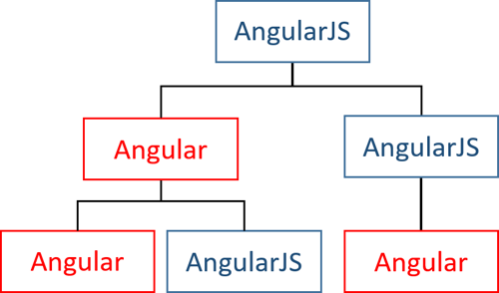
Introduction
AngularJS (formerly Angular 1) and Angular 7 are essentially different frameworks
Angular 2 through 7 are different versions of the same new framework
Migration process involves running both frameworks side-by-side (hybrid app)
AngularJS and Angular 7 components/services can interoperate via ngUpgrade library
Notes:
For those that don’t know, when Google came out with Angular 2, they decided to start over from scratch and release a brand new framework, completely different from Angular 1.
Angular 1 was then renamed to AngularJS
Because they are so different, migrating is a bit difficult and requires refactoring much of your application
For any medium to large scale app, migrating in one go is not possible.
The migration process involves running both AngularJS and Angular 7 side-by-side and migrating components or services one at a time resulting in a hybrid application with a mix of AngularJS and Angular 7 components working together utilizing the ngUpgrade library
Eventually you will finish migrating each component and have a complete Angular 7 app and you can remove AngularJS

Slide 5
Introduction - Angular CLI
Angular 2 also introduced Angular CLI
Code Generation/Scaffolding
Builds + Bundles app
JS/CSS/HTML optimization, AOT compilation
Development server
Unit + E2E testing, linting
Minimal configuration with settings in angular.json, customizable with Angular Builders (Angular 6+)
Notes:
Angular 2 also introduce the Angular CLI, which is a command line tool that
can auto generate initialization and scaffolding code for you application
build and bundle both development and production version of your application,
Automatically optimizes your Javascript, CSS and HTML, does AOT compilation
Launch development server with your app ready to run with automatic rebuild/refresh and sourcemaps already setup
Run your unit and e2e tests as well as lint your application.
Angular CLI utilizes webpack under-the-covers and its webpack configuration dynamically generated at build-time using settings in a file called angular.json and customizable using angular-builders.

Slide 6
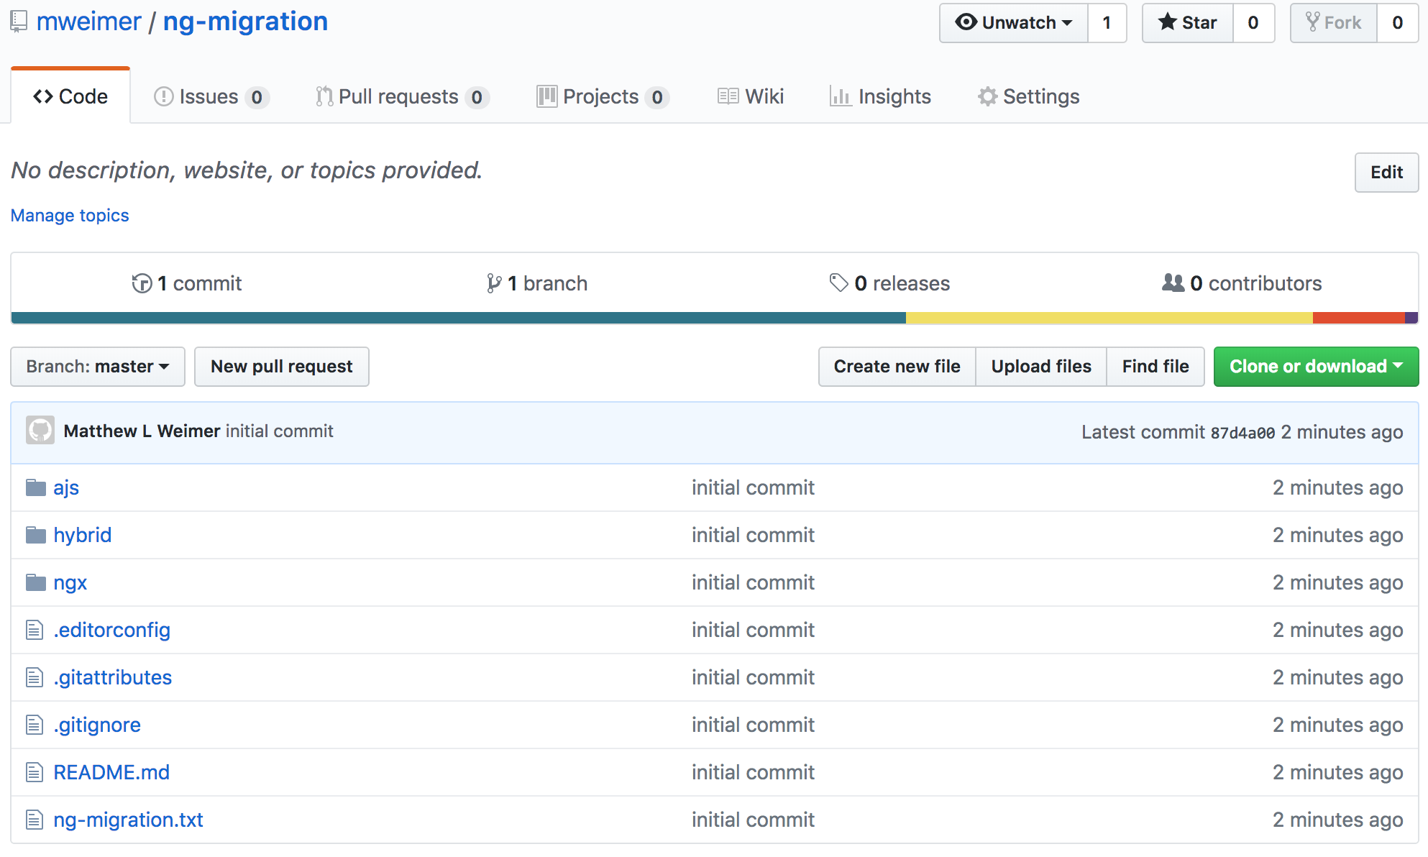
Github project
https://github.com/mweimer/ng-migration
Notes:
Github project which demonstrates the entire migration process
Three different versions of the same app
All AngularJS version utilizing webpack with a whole suite of various of self-selected and self-configured packages for building/optimizing/bundling code, as well as for the dev server, testing, linting
Hybrid version that is about 50/50 AngularJS and Angular 7 and also replacing custom webpack setup with Angular CLI
All Angular 7 version also using Angular CLI
All slide examples from this repo
Thse slides will be up there as well as a longer version of slides

Slide 7
Demo
http://localhost:4200

Slide 8
Migration prep
Use a module loader
AngularJS 1.5 components
Refactor code to not use $scope or $rootScope
Use ES6 classes or Typescript classes
Notes:
Before you start migration, there are several thing you can do to your AngularJS app ahead of time to make the migration process easier
The first is to use a module loader like Webpack, Browserify, or SystemJS. Angular 7 utilizes webpack and Typescript imports
Loading all your code with a bunch of a lot script tags, using IIFEs or code concatenations will need to be removed before hybrid app can be built
Would almost consider moving to a module loader as a pre-requirement, otherwise you will be adjusting all your code during setup for hybrid app
AngularJS 1.5 introduce components which can be used in place of directives. The way components bind templates directly to the component controller is more inline with the Angular 7 template bind to the component class, which will require less refactoring
Also only AngularJS components are compatible with ngUpgrade library and can be used in Angular 7 components.
AngularJS directives can be used in a hybrid app but only by AngularJS components
The concept of $scope doesn’t exist in Angular 7, any code utilizing $scope and $rootScope will need to be refactored.
Pretty much all Angular 7 file are defined in Typescript class, so having code in classes make migration simpler

Slide 9
What’s in the talk
Introduction to Angular migration
Step-by-step Angular migration from AngularJS to Angular 7
Phase 1 - Bootstrap hybrid app, move to Angular CLI
Phase 2 - Migrate AngularJS code to Angular 7
Phase 3 - Remove AngularJS
Notes:
In the first part - I’m going to give you a little bit background information
Then we’re going to talk about phase one which is how to setup what’s called a hybrid Angular app and how to setup the Angular CLI
Then we’re going to walk through a couple of examples of migrating AngularJS components to Angular 7
Lastly, we’ll look at how to cleanup AngularJs from your project

Slide 10
PHASE 1 Bootstrap hybrid app, move to Angular CLI

Slide 11
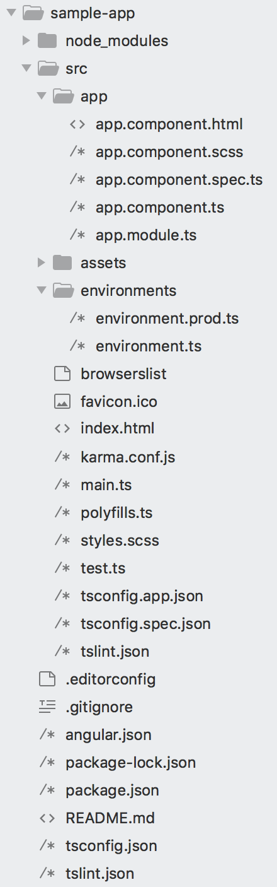
Install CLI - Create sample app
Install Angular CLI
npm install -g @angular/cli
Create Angular 7 sample app for reference
ng new sample-app
Notes:
To get started you want to install the angular cli, you can use this npm command to install it globally
Next you will want to create a sample Angular 7 app somewhere outside your AngularJS project, using the ng new command
Take some time to look at the Angular 7 project files and structure and get familiar with their contents
Most of these project files are needed by the Angular CLI with a default configuration and we will be actually be copying most of them from sample app into our existing AngularJS project

Slide 12
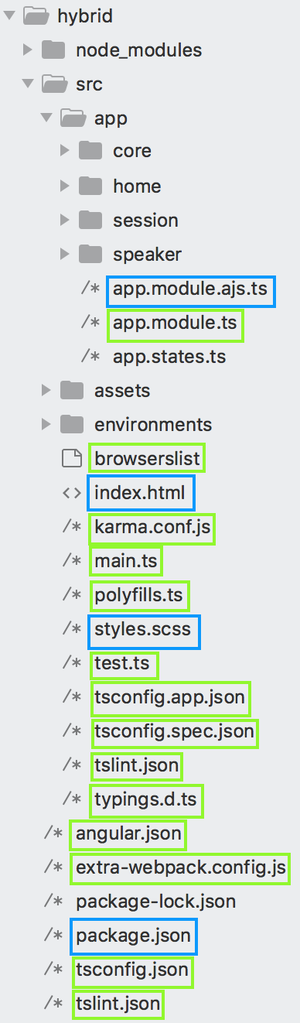
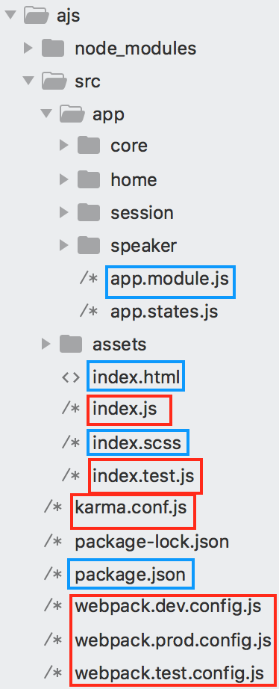
Notes:
So on the left is our AngularJS application and on the right is our hybrid application
In this first phase our goal is to go from the left to right
We will remove the index js entry point files, the karma config and all our build configuration all marked in red
We will add a bunch of new files need by the Angular CLI, these are marked in green, almost all of these we are going to be copied from the sample app we generated
A few files will need to be tweaked to bootstrap the hybrid app and provide extra config needed for uir-router in the hybrid state, these are marked in yellow

Slide 13
Switch to Typescript
Hopefully just:
find . -name "*.js" -exec rename 's/\.js$/.ts/' '{}' \;
Common quick fixes:
Cast DOM object to correct sub-type
Mark function arguments as optional
Notes:
After creating a sample project we will next switch our application from using Javascript to Typescript
As Typescript is a superset of JavaScript this process is hopefully simple as running this bash command to rename our .js files to .ts
The Angular CLI will handle Typescript compilation and transpiling so there is not much to do with the configuration
You may have a few compilation errors when you eventually build the project
Most of the issue we ran into were
Cast some DOM object to correct sub-type
Mark function arguments as optional

Slide 14
package.json
Install all packages from sample app’s package.json
Install dependencies:
@angular/upgrade
@uirouter/angular-hybrid
@angular/router
Install dev dependencies:
@types/angular
@types/node
@types/angular-mocks
Uninstall old build tool packages* + @uirouter/angularjs
Replace scripts commands with those from sample app
Notes:
After switching to Typescript, we will next install all the new npm packages we need and cleanup the old one we don’t need
You will want to copy all the packages found in the sample app’s package.json bothe regular dependencies and dev dependencies
You will also want to install 3 additional packages
angular upgrade is the ngUpgrade library that will allow our app to run as a hybrid
ui-router angular hybrid is the special version of ui-router for hybrid apps
Angular router is the regular is the standard Angular 7 router but is required by ui-router
You want to install 3 dev dependencies that will provide type information to the Typescript compiler
You can remove any old packages related to your old build tools as well as ui-router for AngularJS
You’ll also want to replace the start, build, test and lint commands in your script section with those found in the sample app

Slide 15
Files to directly copy from sample app
tsconfig.json
src/tsconfig.app.json
src/tsconfig.spec.json
tslint.json
src/polyfills.ts
src/browserslist
src/environments/environments.prod.ts
src/environments/environments.ts
src/karma.conf.js (can remove old karma config)
Notes:
Once we have switched to Typescript and installed all our npm packages we can begin adding new files from the sample app
You will want to directly copy all these files directly from the sample app to our hybrid app with little to no changes
Make sure to copy them to the correct sub directories here
The tsconfig is the configuration for the Typescript compiler
tsconfig.app and sconfig.spec, these extend the main config file, spec is used for unit test build, app is used for everything else
tslint contains all our linting rules, you can adjust these to your preferences later but the default file helps to enforce a lot of good Angular 7 best practices
polyfills imports various polyfill modules for older browsers, there a bunch of commented out imports in here that you can uncomment later based on the support you need. Some require additional npm packages, it says in the file what you need to install

Slide 16
Files to copy and modify
angular.json
src/styles.scss
src/tslint.json
src/app/app.module.ts
src/main.ts
src/test.ts
Notes:
We need these 6 files from the sample app as well but we will need to modify them

Slide 17
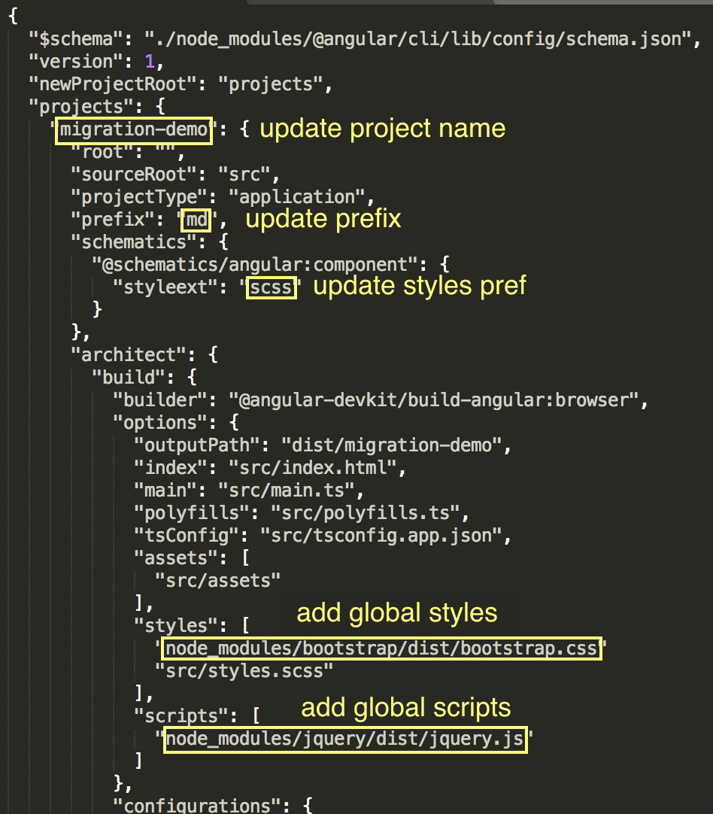
angular.json
Notes:
angular.json is the main config file for the entire Angular project, its used to generate the webpack config used by the CLI at build time
You want to start by copying the angular.json from the sample app to your hybrid app
Go though highlights
Angular CLI supports SASS, LESS and regular CSS

Slide 18
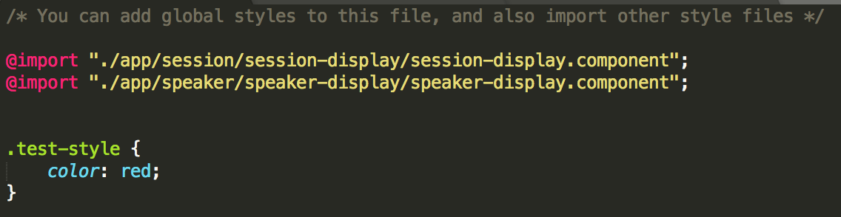
src/styles.scss
Include any global, application-wide styling here
Notes:
Copy from sample app this file is actually empty initially
In my demo app I had a single global stylesheet for the AngularJS app and I just moved everything from there into here

Slide 19
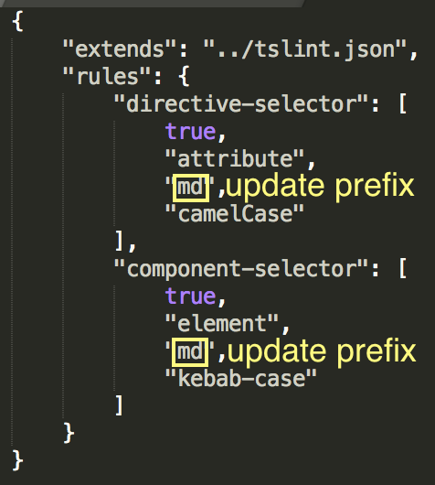
src/tslint.json
Notes:
This file just extends the main tslint file, all you need to do here is to update the application prefix to match what’s in the angular.json file

Slide 20
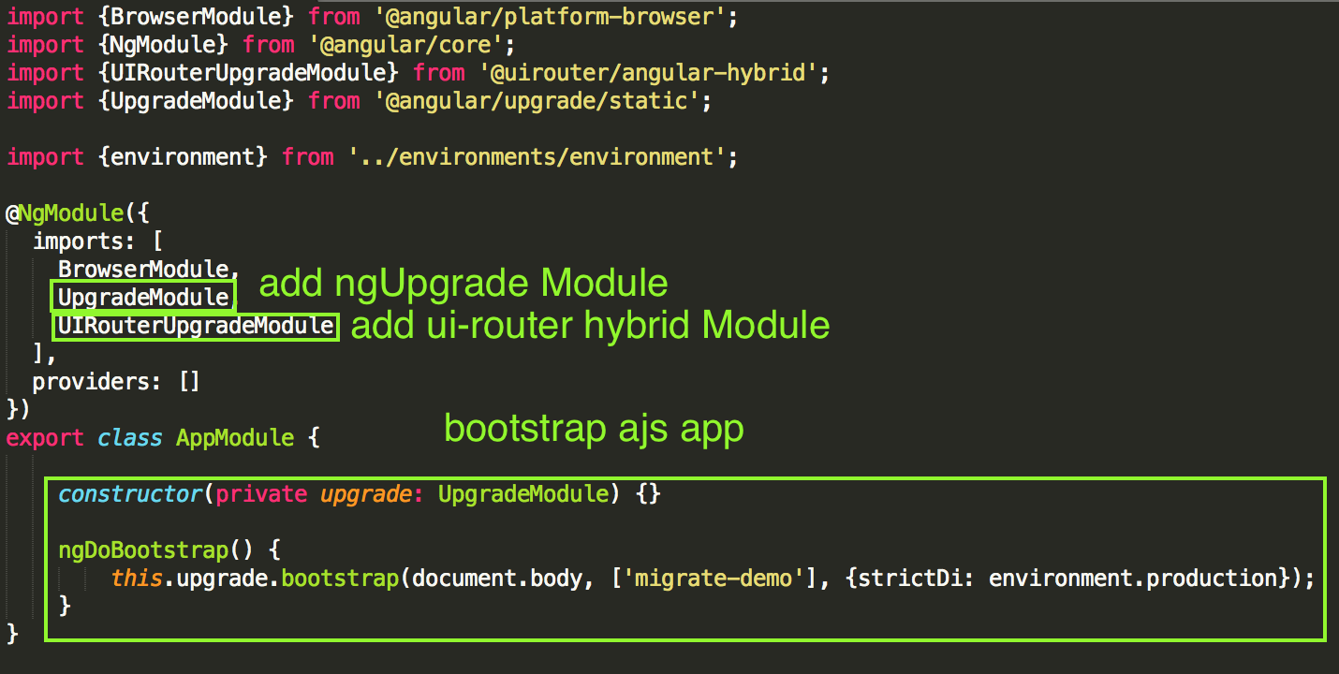
src/app/app.module.ts
Notes:
App.module.ts is the root module for our entire Angular 7 app
In my demo I already had an app.module.ts for the AngularJS root application module so I renamed that file by appending ajs to the file name
After you copy this file from the same up to want to import 2 new modules, one for the ngUpgrade library and one for ui-router hybrid version
You also need to add this code snippet to the App Module class in order to bootstrap the AngularJS app and create the hybrid app

Slide 21
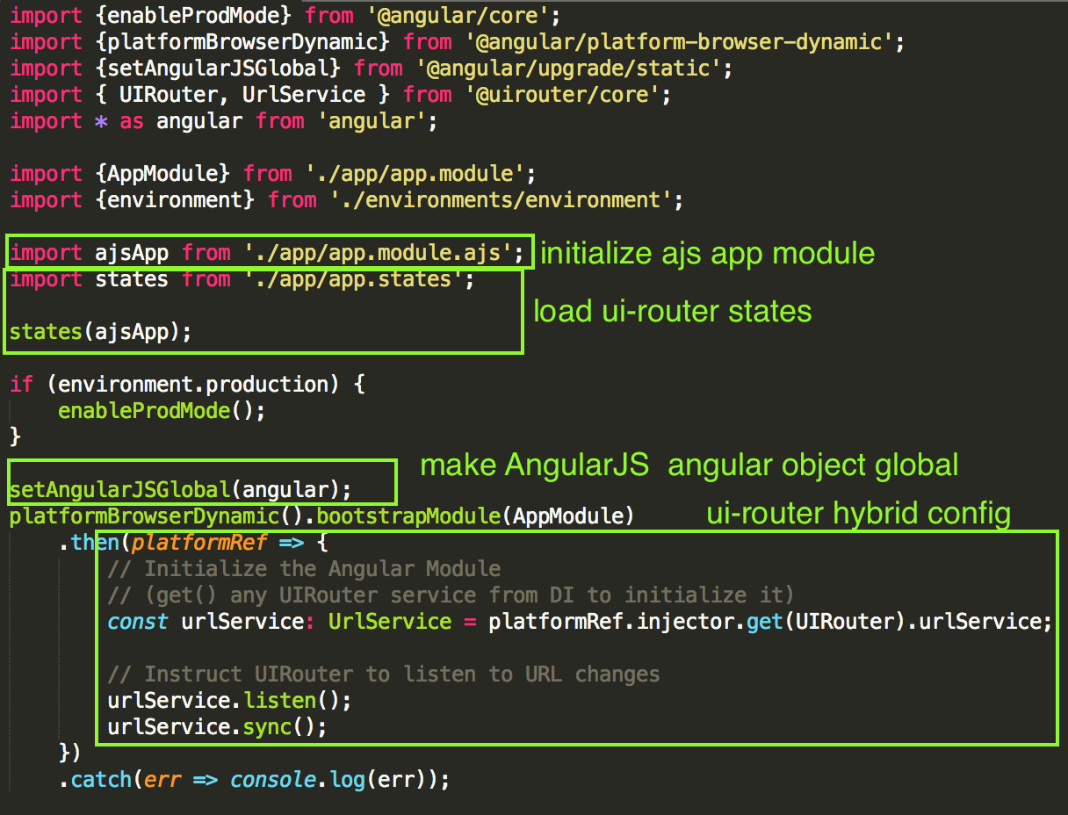
src/main.ts
Notes:
Main.ts is the entry point for the application code
After we copy it we will need to add several things
First we initialize our AngularJS app and add to it our ui-router states, it possible to load the states in a few different ways this is just how i chose to do it
Second, we make the angular object from the AngularJS library global using setAngularJSGlobal function from the ngUpgrade library
This allows us to use the angular object (point out above) in any of our file without doing a typescript import, without this we would have to add the import to pretty much every file
Lastly add a little bit of config need for ui-router when its running in the hybrid state

Slide 22
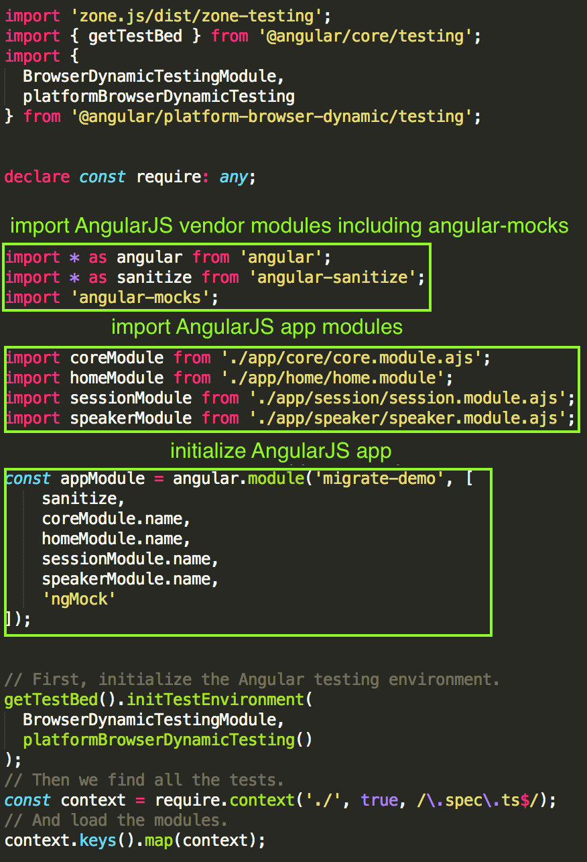
src/test.ts
Notes:
Test.ts is the entry point for our application code when we are running unit tests
Once we copy it from the sample app we must initialize our AngularJS, making sure to also include the angular-mocks module
You may not need the ui-router modules, depending on your tests

Slide 23
Other files
src/app/app.module.ajs.ts (our old app.module.ts)
src/index.html
src/typings.d.ts
Notes:
We also need to setup up these 3 files
The first 2 our existing files
The last is new

Slide 24
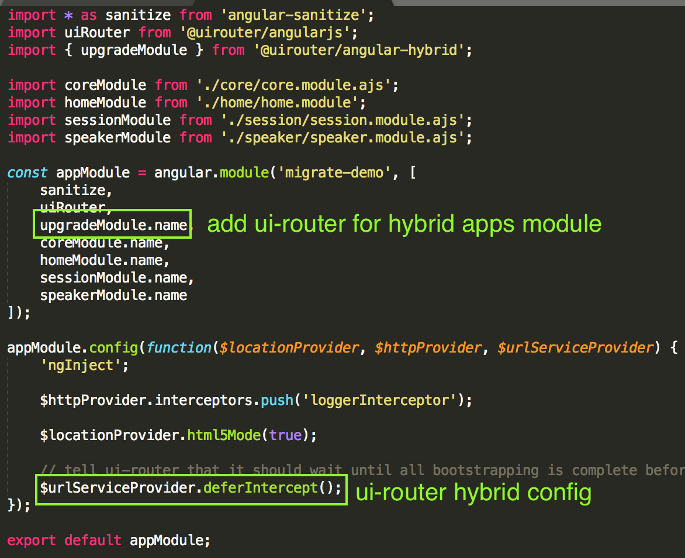
src/app/app.module.ajs.ts
Notes:
This file is the root application module for our AngularJS app, we has to rename it as app.module.ts is now for our Angular 7 app module
As we migrate we will be creating new Angular 7 module files, so you may want to go-ahead and rename your all your AngularJS module files
In here we need to also import the uir-router hybrid module
Additionally we need to add one line need by ui-router in the hybrid state

Slide 25
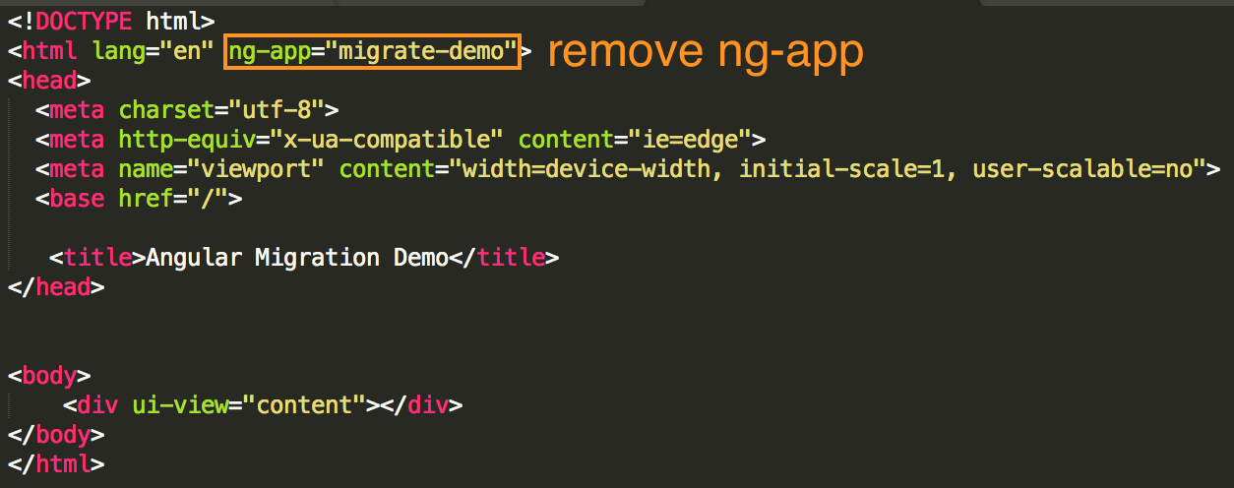
index.html
Notes:
In our index.html all we need to do is remove ng-app
If you remember bootstrapping the AngularJS app in now done in app.module.ts,
If you forget to do this it will load the AngularJS app twice and give weird behavior
If you are using the alternative angular.bootstrap() function instead of ng-app, remove that from code wherever it is

Slide 26
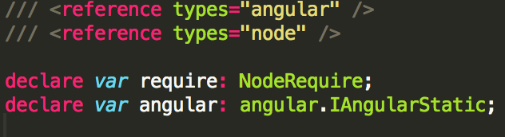
src/typings.d.ts
Create this file, doesn’t exist in Angular 7 sample app
Add typing for angular + node
Notes:
Typings.d.ts is a new file that doesn’t exist in the sample app
This file provide type information to the Typescript compiler for some global objects
If you don’t you the require function to import files in your code, you don’t need that

Slide 27
Angular builders
May need to configure build beyond what can be set with angular.json
Customize the webpack config using third-party angular builder or create your own
Notes:
Certain parts of your build are configurable through settings in the angular.json file
However, you may need to change something and there is no configuration setting for it
Angular builders are responsible for generating the webpack config used by the CLI
The default ones are extendable so that you can replace it with one that provides the extra changes you need
For example if you look in the demo app you can see how i used angular builder to add the ng-annotate loaded

Slide 28
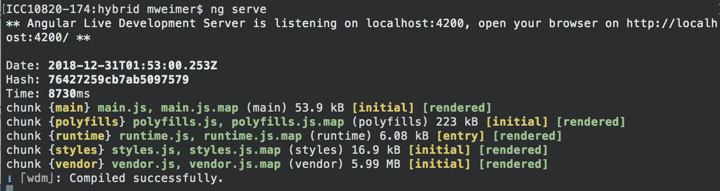
ng serve
Notes:
At this point we have finished setting up our hybrid app
It is also ready to be built by the cli and will bootstrap both frameworks
Even though we haven’t migrated any individual components it is a hybrid app
Simply do ng serve on the command line to build your application and launch a dev server
Will probably have some errors to chase down and fix

Slide 29
What’s in the talk
Introduction to Angular migration
Step-by-step Angular migration from AngularJS to Angular 7
Phase 1 - Bootstrap hybrid app, move to Angular CLI
Phase 2 - Migrate AngularJS code to Angular 7
Phase 3 - Remove AngularJS
Notes:
In the first part - I’m going to give you a little bit background information
Then we’re going to talk about phase one which is how to setup what’s called a hybrid Angular app and how to setup the Angular CLI
Then we’re going to walk through a couple of examples of migrating AngularJS components to Angular 7
Lastly, we’ll look at how to cleanup AngularJs from your project

Slide 30
PHASE 2 Migrate AngularJS code to Angular 7
Notes:
Phase 2 - Migrating AngularJS code to Angular 7
this we’re we actually begin the migration process
To give you a brief idea of what this involves were going to look a couple of examples

Slide 31
Migration strategy
Bottom-up
Feature-by-feature
Interceptors needed before HttpClient is used
Filters and Attribute Directives need migrated before components that use them are migrated
Notes:
When deciding which parts of your app to migrate first, there are a few factors to consider
To make a component and service usable and the other framework, the hybrid app requires a small amount of boilerplate code which called downgrading or upgrading
It’s easier to downgrade components and services than it is upgrade them
For this reason, I recommend starting with the lowest level components and working your way up
It best to do an entire feature or module at once before moving to another feature
Migrating services in a feature module before you do the components might be better so you can insure you code follows the Observable pattern used by RxJS
AngularJS attribute directives, filters, and interceptors can’t be upgraded
You must create Angular 7 versions before they’re needed in ng7 code
After creating the Angular 7 version, the AngularJS version may still be in use, so may have to keep both version throughout the migration process, remove at end

Slide 32
Migrating components
Convert file to Typescript class
Use @Component decorator to import styling/template and define selector
Inject dependencies with constructor
Use @Input + @Output decorators on public properties for bindings
Use lifecycle interfaces to create lifecycle hooks
Notes:
We are going to start with migrating a single component

Slide 33
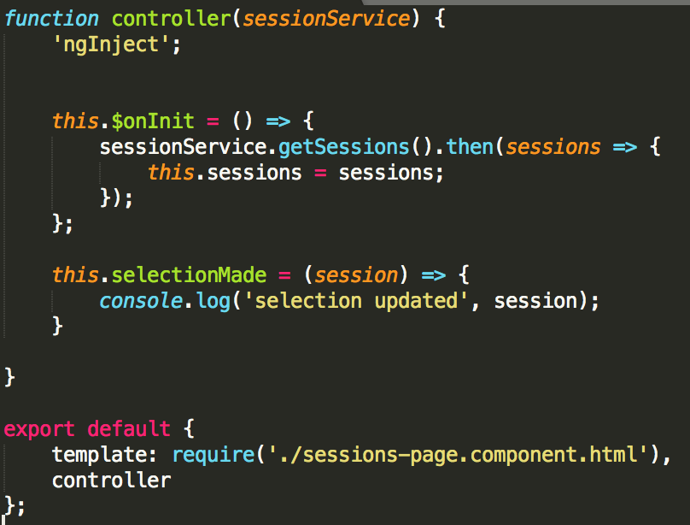
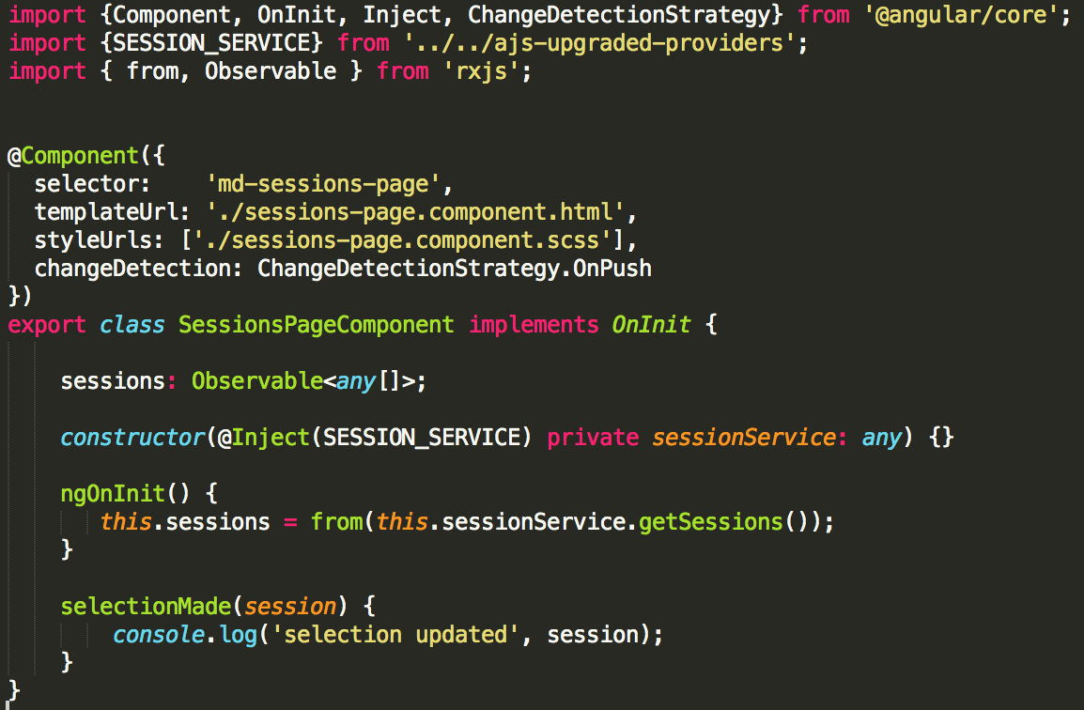
sessions-page.component.ts (ajs)
sessions-page.component.ts (ngx)
Notes:
So here we have the controller for Sessions Page component which just retrieves a list of codemash sessions and displays them in a list
All of the code has been moved into a Typescript class
We also have a @Component decorator
Selector should be kebab-cased, with app prefix matching what’s in angular.json and tslint config file
We moved are now importing the stylesheet in the component and removed it from the global stylesheet, reminder, when importing in the component, all styles by-default will be scoped to this component, this is called view encapsulation
You can turn off view encapsulation using encapsulation property in the decorator, the styles will be global but, this is important, the styles won’t be loaded until the component is loaded for the first time in the app
If one of the reasons you are migrating is for better performance, then I highly recommend using OnPush change detection
The default change detection works similarly to AngularJS in that it is continually checking and updating your template all the time
OnPush only updates a template when an event occurs like an input changes a DOM event like a click occurs, an observable being binded to in the template updates, or you manually tell the change detection to update in your code
If you want to easiest migration path you can use default as it will require less refactoring of your code
Using onpush generally requires refactoring parts of your code to bind to observables so it will update when needed
If you look at the constructor we are injecting dependencies there
Session service is AngularJs service that has been upgraded, since it has no class and we have to have a injection token to identify it
DI in Angular 7 generally relies on the class of the depency, if it doesn’t have one it needs a token
Since our AngularJS component is using the OnInit hook, our Angular 7 component is implementing the OnInit interface
In Angular 7 - you don’t actually need the interface just the hook function, but it’s a good practice to add so the compiler can check that you have the correct name, arguments, and types
When we call the session service it is still returning a promise, we would like our code to use the observable pattern preferred by Angular 7 - so we use the “from” function to convert the promise to an observable

Slide 34
Angular template syntax
AngularJS | Angular 7
ng-repeat="session in $ctrl.sessions" | *ngFor="let session of sessions"
ng-if="$ctrl.sessions.length > 0" | *ngIf="sessions.length > 0"
{{session.title | capitalize }} | {{session.title | uppercase }}
<my-component some-input="$ctrl.firstName"> | <my-component [someInput]="firstName">
<div ng-class="{'active': $ctrl.isActive}"> | <div [ngClass]="{'active': isActive}">
<button ng-click="$ctrl.buttonClicked()"> | <button (click)="buttonClicked()">
<input ng-model="$ctrl.userName"> | <input [(ngModel)]="userName">
https://angular.io/guide/cheatsheet
Notes:
Angular 7 does have different template syntax than Angular 7,
Ng-if and ng-repeat have slightly different syntax
Interpolation still works the same, filter work the same way as pipes
Angular 7 uses camel-casing instead of kebab casing for component input and outputs as well as attribute directive
Another thing to note is square braces denote input while parentheses denote output
Ng-model has both since it is a two-way binding

Slide 35
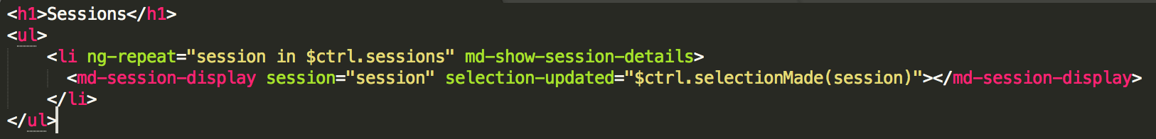
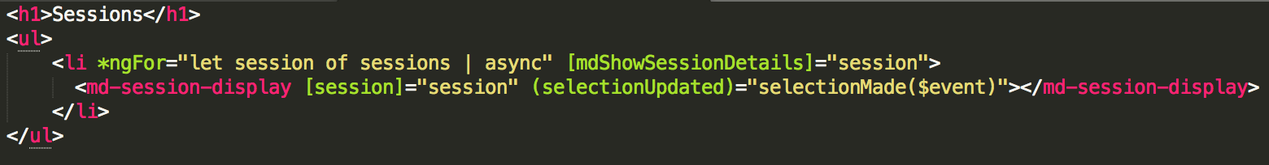
sessions.page.component.html (ajs)
sessions.page.component.html (ngx)
Notes:
So here is the migration for our session page compone
Here we have updated ng-repeat to now be ngFor
We’re using async pipe allows you to use observable or promise directly in template,
If you uses observables in your component class and call the subscribe function and the the observable is infinite, you have to manually unsubscribe from that observable to avoid memory leaks
The nice thing about the async pipe is handle subscribing to the observable for you and automatically unsubscribes on component destruction
The md-show-session-details is an attribute directive - it now uses camel-case and square brackets
If you remember directives can’t be upgraded so this is a migrated Angular 7 version
md-session-display is still an AngularJS component, it has been upgraded

Slide 36
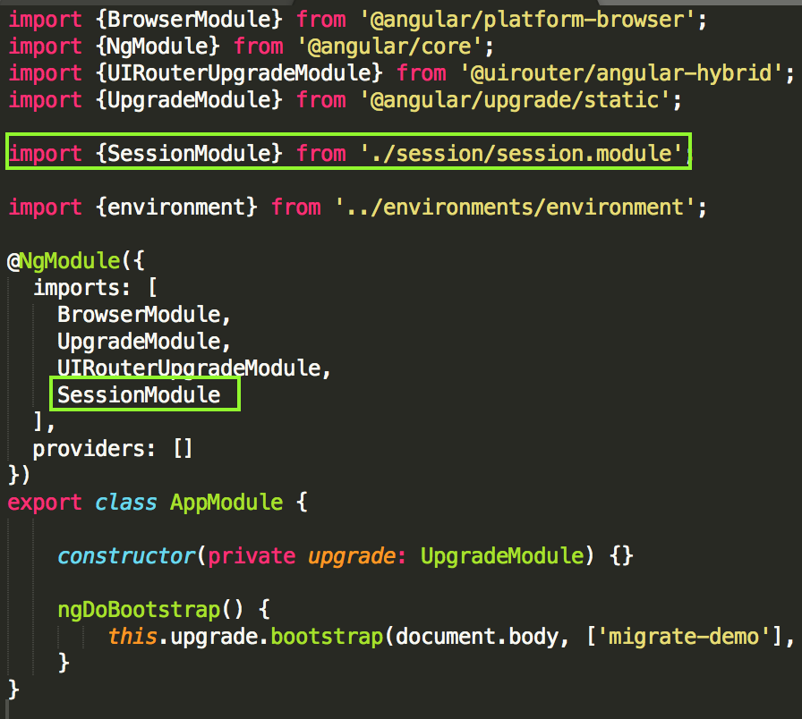
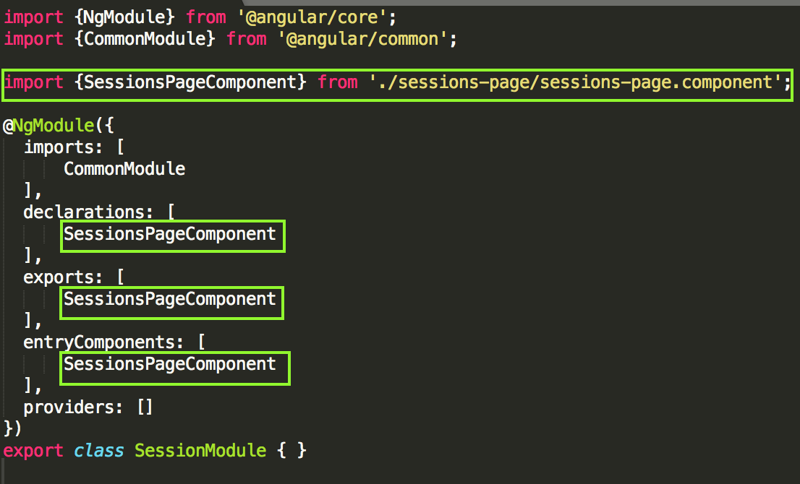
Migrating components: Updating module
app.module.ts
session.module.ts
Notes:
On the left is our session feature module, since this is the first thing migrated from this component we need to create it, will need to rename the old angularJS module
When we create a new module we need to add it to the root app module
All components need to be added to declarations in it module
Entry components is for any component that is used but not by declaring it in Angular 7 template this includes components that get downgraded
Export used for any component used outside its module not including downgraded components

Slide 37
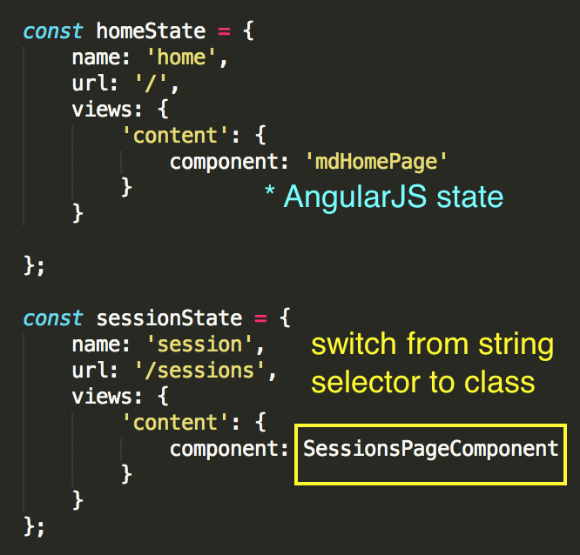
Migrating components: Update ui-router states
app.states.ts
Notes:
If component is used by ui-router in state declaration then you need to update that state after migration
Upgrading the state declaration is as easy as switching the AngularJS string selector to the component class

Slide 38
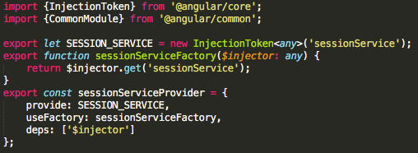
Upgrading AngularJS services
session.service.provider.ts
Notes:
You saw the AngularJS session service used in an Angular 7 component to make that happen we need upgraded it
You need to add 3 things to make this happen - an injection token, a factory function and a provider
This is all just boilerplate code, just switch the names in it
You then need to add the provider to an Angular 7 module - I’m adding the session service to the session module here
Then you can inject the service in an Angular 7 component
I’ve elected to make a separate provider file for the boilerplate code and add it to the Angular 7 module it will eventually be migrated too,
You can choose to put all the upgrade service file and create a separate module for those services if you choose.

Slide 39
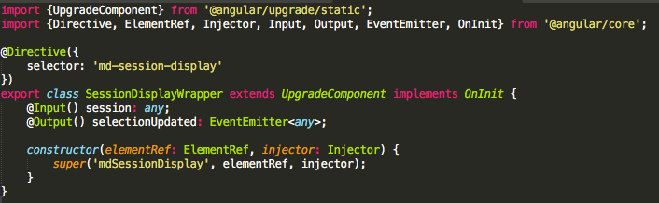
Upgrading AngularJS components
session-display.wrapper.ts
Notes:
You saw the AngularJS session display component used in an Angular 7 component to make that happen we need upgraded it
To upgrade a component we need to create a wrapper class for it
The wrapper class extends the UpgradeComponent class, which is part of the ngUpgrade library, and contains some boilerplate in the constructor
For each binding in the AngularJS class we need to add a public property and decorate it with either the input or output decorator
If the component has lifecycle hooks we need to add the appropriate lifecycle interface to the wrapper class

Slide 40
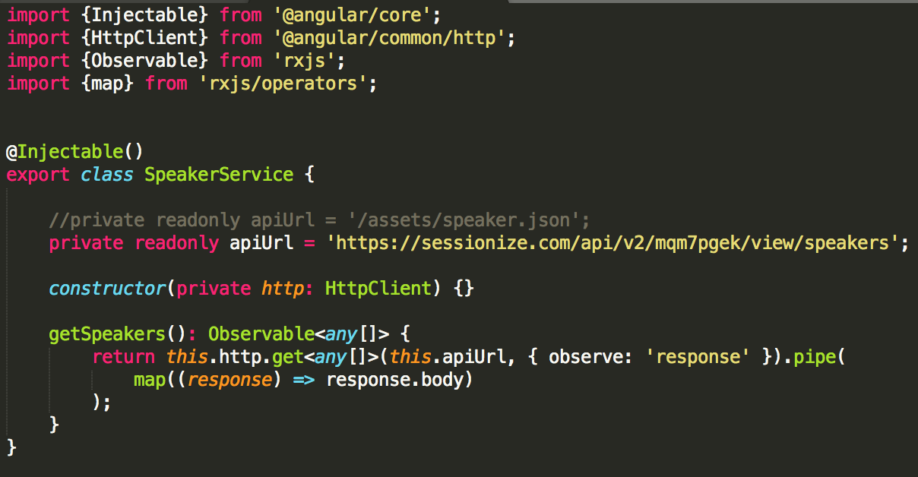
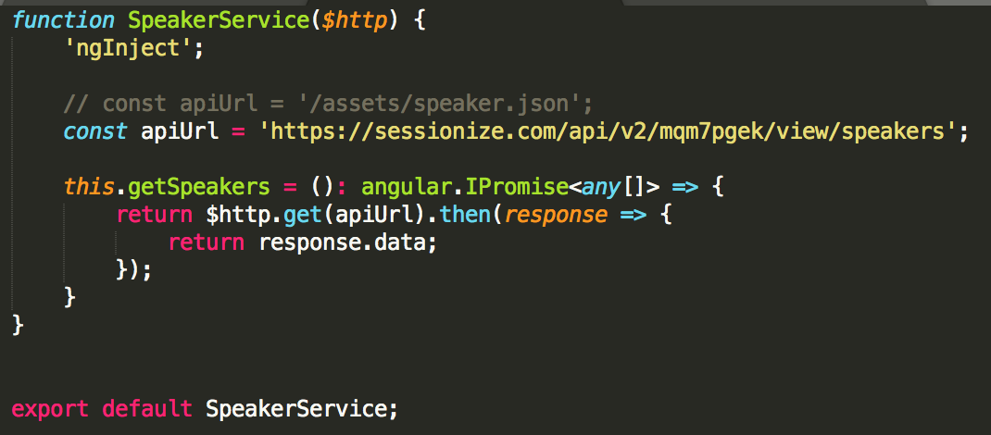
Migrating services
speaker.service.ts (ajs)
speaker.service.ts (ngx)
Notes:
So here we have the speaker service which just retrieves our speaker data
Once again we have moved our code into a typescript class
We have added the injectable decorator to the class
We are injecting the http client which the http service for Angular 7
DI in Angular 7 relies on the depency class or token, not the argument name like AngularJS, so we can name it whatever we want
Lastly, we convert from the promise pattern to the observable pattern since the http client returns an observable

Slide 41
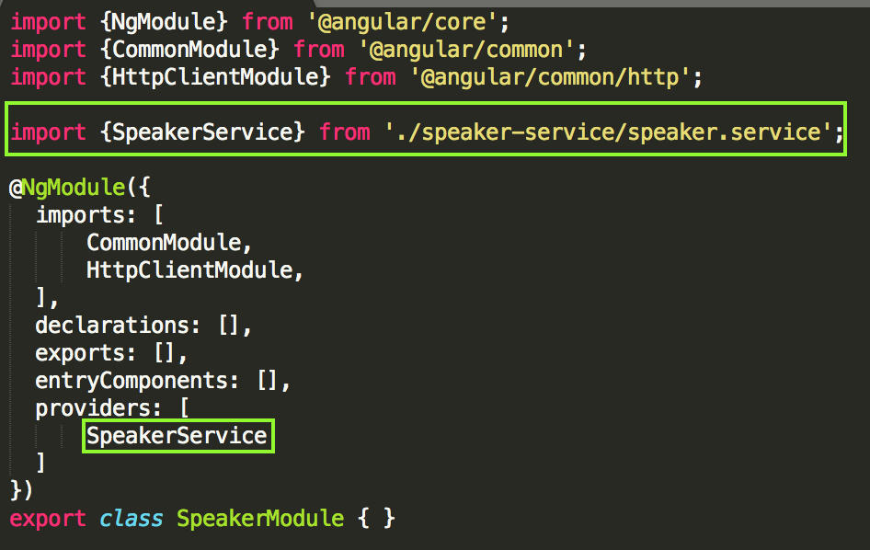
Migrating services: Updating module
speaker.module.ts
Notes:
After converting the service we need to add it to its module
Services get add to the providers list in their module

Slide 42
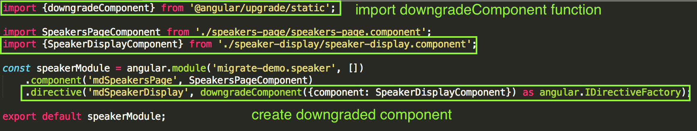
Downgrading Angular 7 components
speaker.module.ajs.ts (ajs)
speakers-page.component.html (ajs)
Notes:
In order for an Angular 7 component to be used in a AngularJS component, you will need to downgrade it
This a pretty easy 2 step process, the first is to make sure the component is listed under entryComponents in its module (not shown)
The second is to call the downgradeComponent function from ngUpgrade Library and add it as directive (not a component) to an AngularsJS module
This is pretty much boilerplate
When using downgraded component in AngularJS template - use Angular 7 square bracket with AngularJS kebab casing for inputs
After speakers-page is migrated - need to update input casing to Angular 7 style camel casing

Slide 43
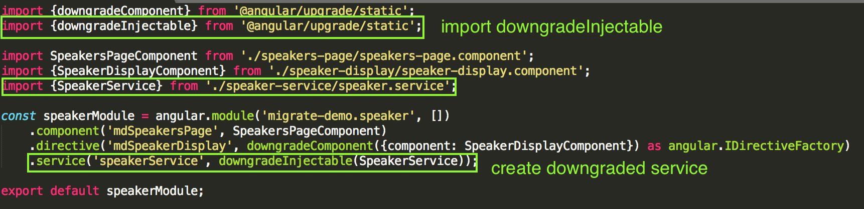
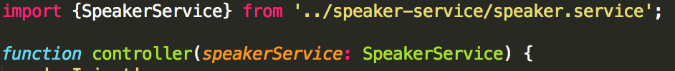
Downgrading Angular 7 services
speaker.module.ajs.ts (ajs)
speakers-page.component.ts (ajs)
Notes:
In order to use a Angular 7 service in a AngularJS component or service, you will need to downgrade it
This is pretty easy and just requires calling the downgradeInjectable from the ngUpgrade library in an AngularJS module
Note: the speaker service class added for typing, but DI in AngularJS still done by name, so has name to match what is in module

Slide 44
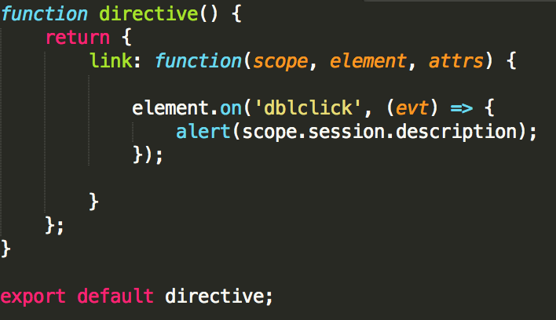
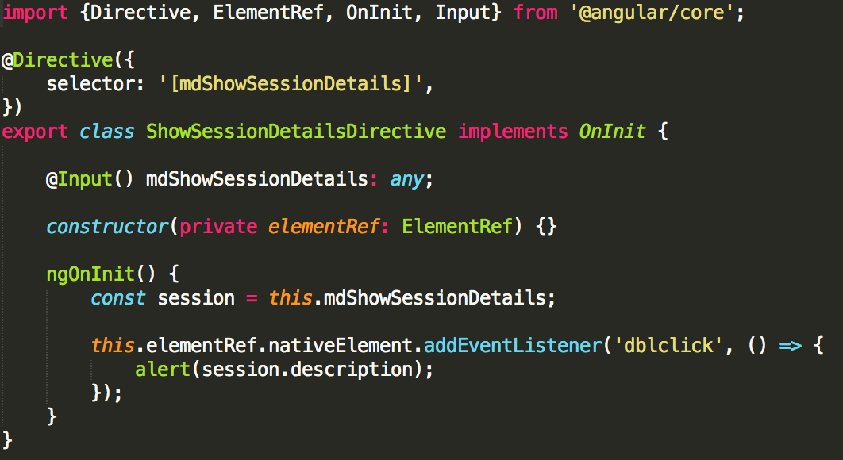
Migrating attribute directives
show-session-details.directive.ts (ajs)
show-session-details.directive.ts (ngx)
Notes:
Migrating an attribute directive is not too much different then a component, just don’t have a template to deal with - not going to go over to much of this
Reminder about needing to do this ahead of time, because directives can’t be upgraded, might have to keep both versions
Camel casing for selector with app prefix

Slide 45
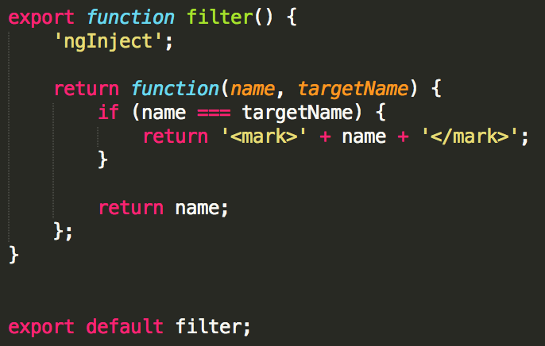
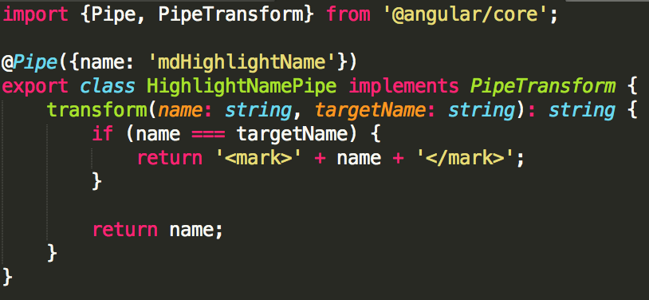
Migrating filters to pipes
highlight-name.filter.ts (ajs)
highlight-name.pipe.ts (ngx)
Notes:
Angular 7 has pipes which are pretty similar to AngularJS filters
Pipes are a little more efficient than filters in that they only get called if one of the inputs change if the pipe is pure
Not going into pure vs impure
Use Pipe decorator with camel casing selector and app prefix
shouldn’t have to change transform function
Reminder about needing to do this ahead of time, because filter can’t be upgraded, might have to keep both versions
Add to declarations list in Angular 7 module

Slide 46
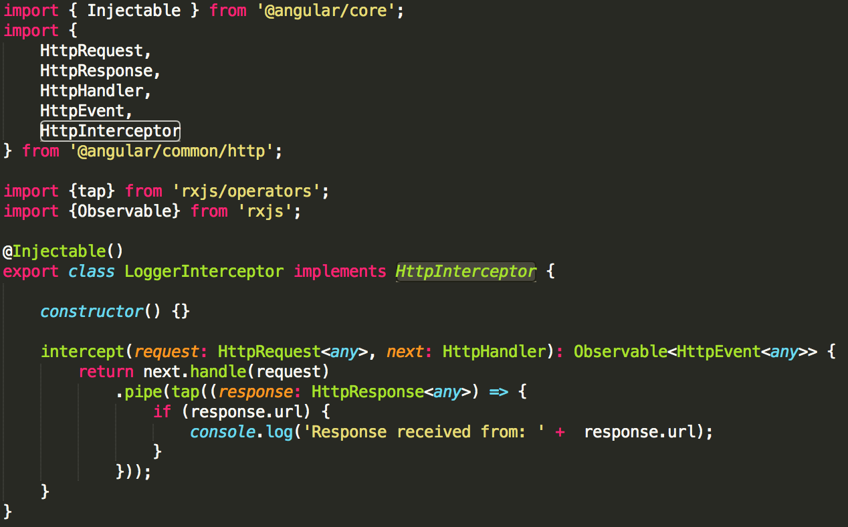
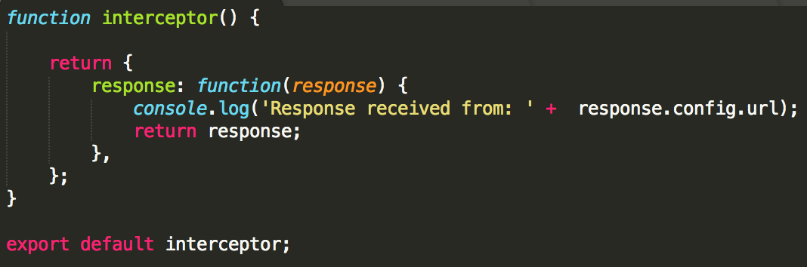
Migrating HTTP interceptors
logger.interceptor.ts (ngx)
logger.interceptor.ts (ajs)
Notes:
For migrating interceptors you’ll end up doing quite a bit of refactoring
While the AngularJS interceptor had 3 different functions you could implement for request, response and error, the Angular 7 interceptor has a single intercept function that utilizes Observables
You’ll want to add the injectable decorator to the class

Slide 47
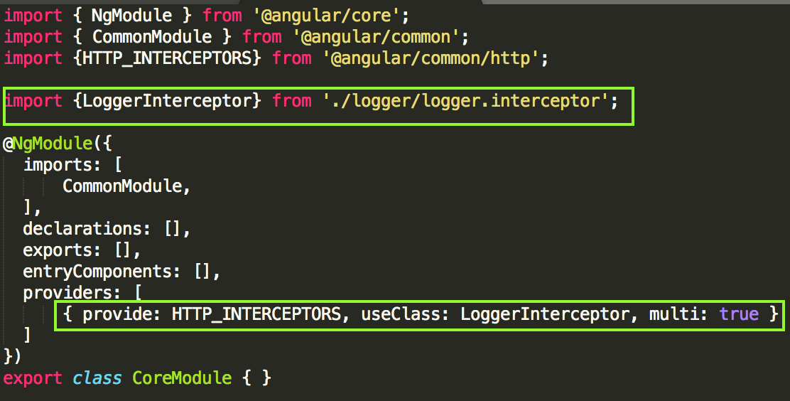
Migrating HTTP interceptors: Updating module
core.module.ts
Notes:
Interceptor get added to a module under the providers list
Note we use the HTTP_INTERCEPTORS token and multi set to true

Slide 48
Unit testing
Mock Angular 7 components/services in AngularJS tests
Mock AngularJS components/services in Angular 7 tests
Or use: https://github.com/angular/angular/pull/16848
createAngularJSTestingModule
createAngularTestingModule
Notes:
Trying to setup a hybrid app in your unit test is rather difficult
Currently, not really any support from the ngUpgrade library
Easiest thing to do is mock everything
If you need real services or component from the other framework - you can use code from this pull request

Slide 49
What’s in the talk
Introduction to Angular migration
Step-by-step Angular migration from AngularJS to Angular 7
Phase 1 - Bootstrap hybrid app, move to Angular CLI
Phase 2 - Migrate AngularJS code to Angular 7
Phase 3 - Remove AngularJS
Notes:
In the first part - I’m going to give you a little bit background information
Then we’re going to talk about phase one which is how to setup what’s called a hybrid Angular app and how to setup the Angular CLI
Then we’re going to walk through a couple of examples of migrating AngularJS components to Angular 7
Lastly, we’ll look at how to cleanup AngularJs from your project

Slide 50
PHASE 3 Remove AngularJS
Notes:
Once all components, services, directives, pipes, and interceptors have been migrated - AngularJS can be removed
Were going to assume we’ve finished migrating each component to Angular 7 in our demo app and our ready move from a hybrid app to pure Angular 7

Slide 51
Clean up leftover files
Delete any leftover AngularJS files like modules, attribute directives, filters or interceptors
Delete any leftover component wrapper or service provider files for downgrading
Notes:
First thing we will do is cleanup and leftover AngularJS files like modules, attribute directives, filters or interceptors
We also want to remove and component wrapper or service provider files for downgrading component

Slide 52
package.json
Uninstall dependencies
angular
any other AngularJS modules like angular-sanitize
@angular/upgrade
@uirouter/angular-hybrid
Install dependency @uirouter/angular
Uninstall dev dependencies
angular-mocks
@types/angular
Notes:
Next we need to modify some of our npm packages
Uninstall dependencies angular any other AngularJS modules like angular-sanitize @angular/upgrade @uirouter/angular-hybrid
Install dependency @uirouter/angular
Uninstall dev dependencies angular-mocks @types/angular

Slide 53
Create App Root component
Create root component that will be entry point for the application
Add to bootstrap array in root App module
Move contents of index.html into app-root.component.html
Put app-root component declaration in index.html
Notes:
Angular 7 apps typically have a single entry point component for the application to bootstrap
We need to set this up, so you want to create a new component called App Root
You will put this component in index.html and move any html from the body of index.html into you app root component
Lastly, you want to list your app-root component as a bootstrap component in your root app module

Slide 54
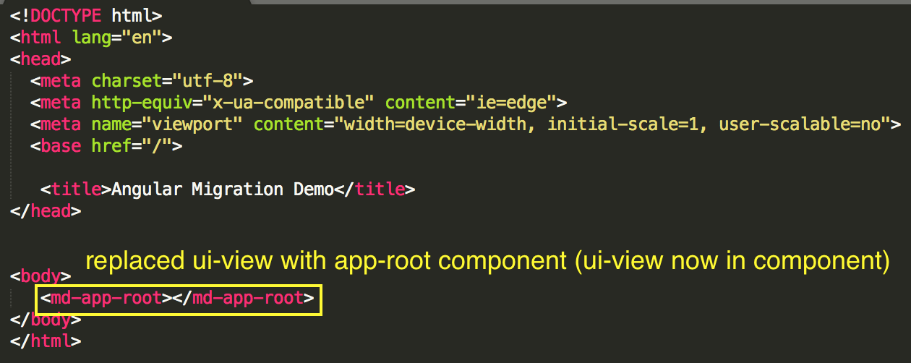
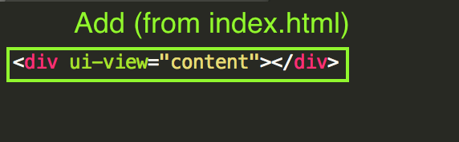
Create App Root component
index.html
app.root.component.html
Notes:
So to see what that looks like - we put the app root component in the index html and move the ui-view into the app root component template

Slide 55
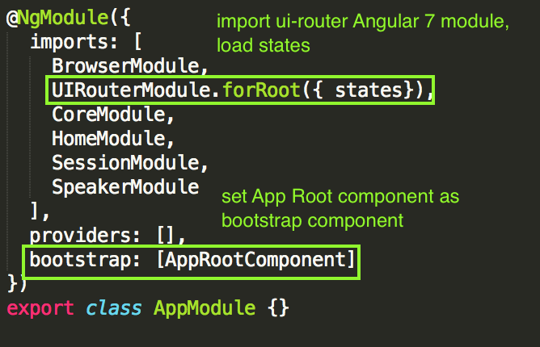
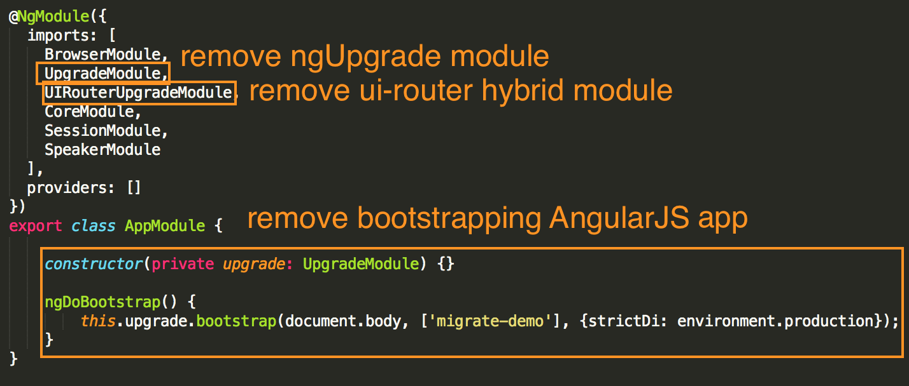
src/app/app.module.ts

Slide 56
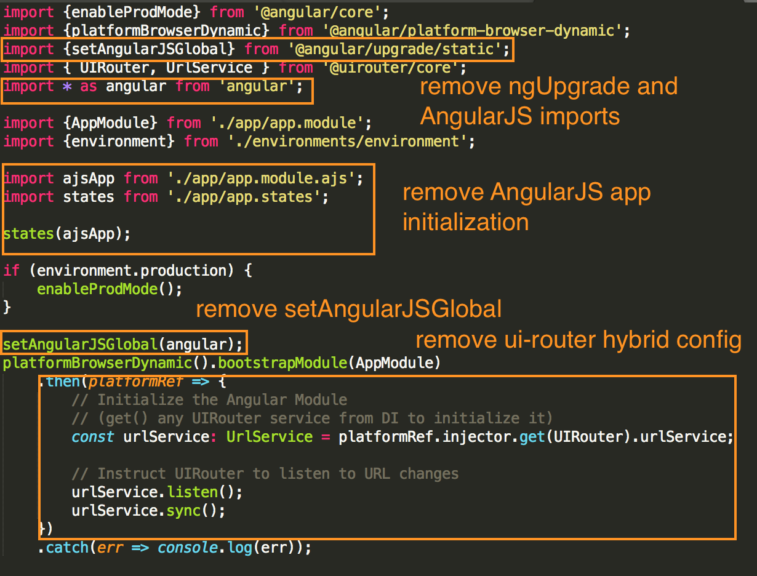
src/main.ts
Notes:
In main.ts we just remove all that stuff we added in phase 1

Slide 57
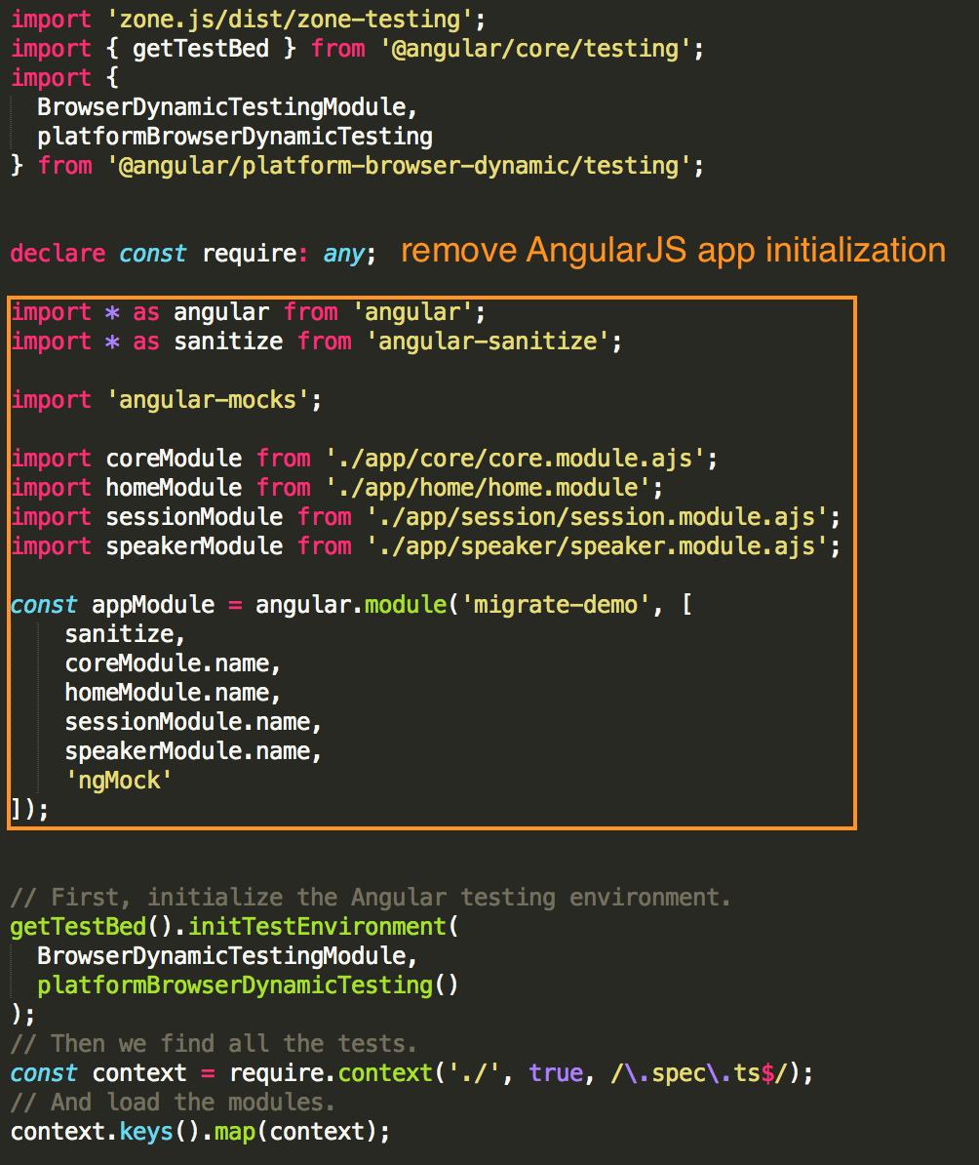
src/test.ts
Notes:
In test.ts we just remove all that stuff we added in phase 1

Slide 58
src/typings.d.ts
Remove any typing for AngularJS
May be able to remove entire file
Notes:
In typings.d.ts we remove the typing for AngularJS, if that all that left in there - we can delete the file

Slide 59
Conclusion
Set up bootstrapping for hybrid app
Set up files and config for Angular CLI
Migrate each component or service one at a time
Clean up AngularJS

Slide 60
Questions

